Slide 1
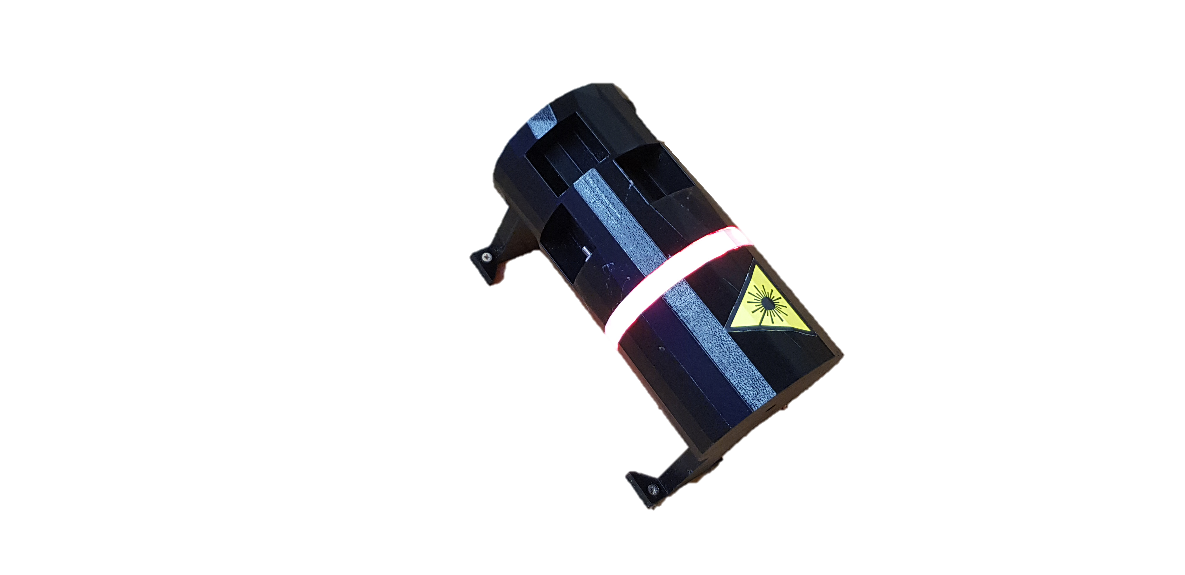
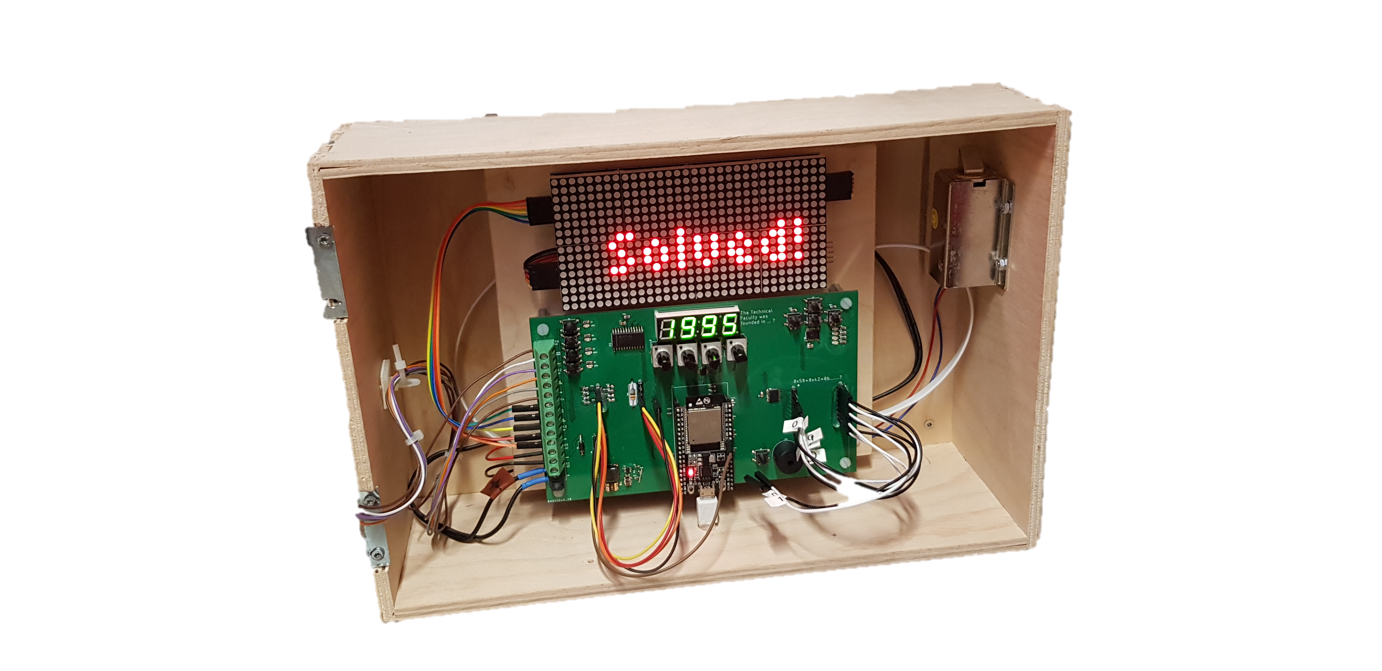
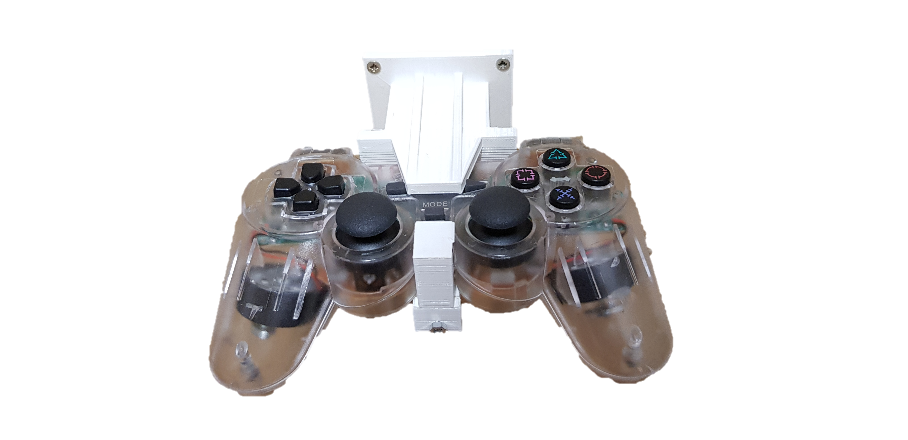
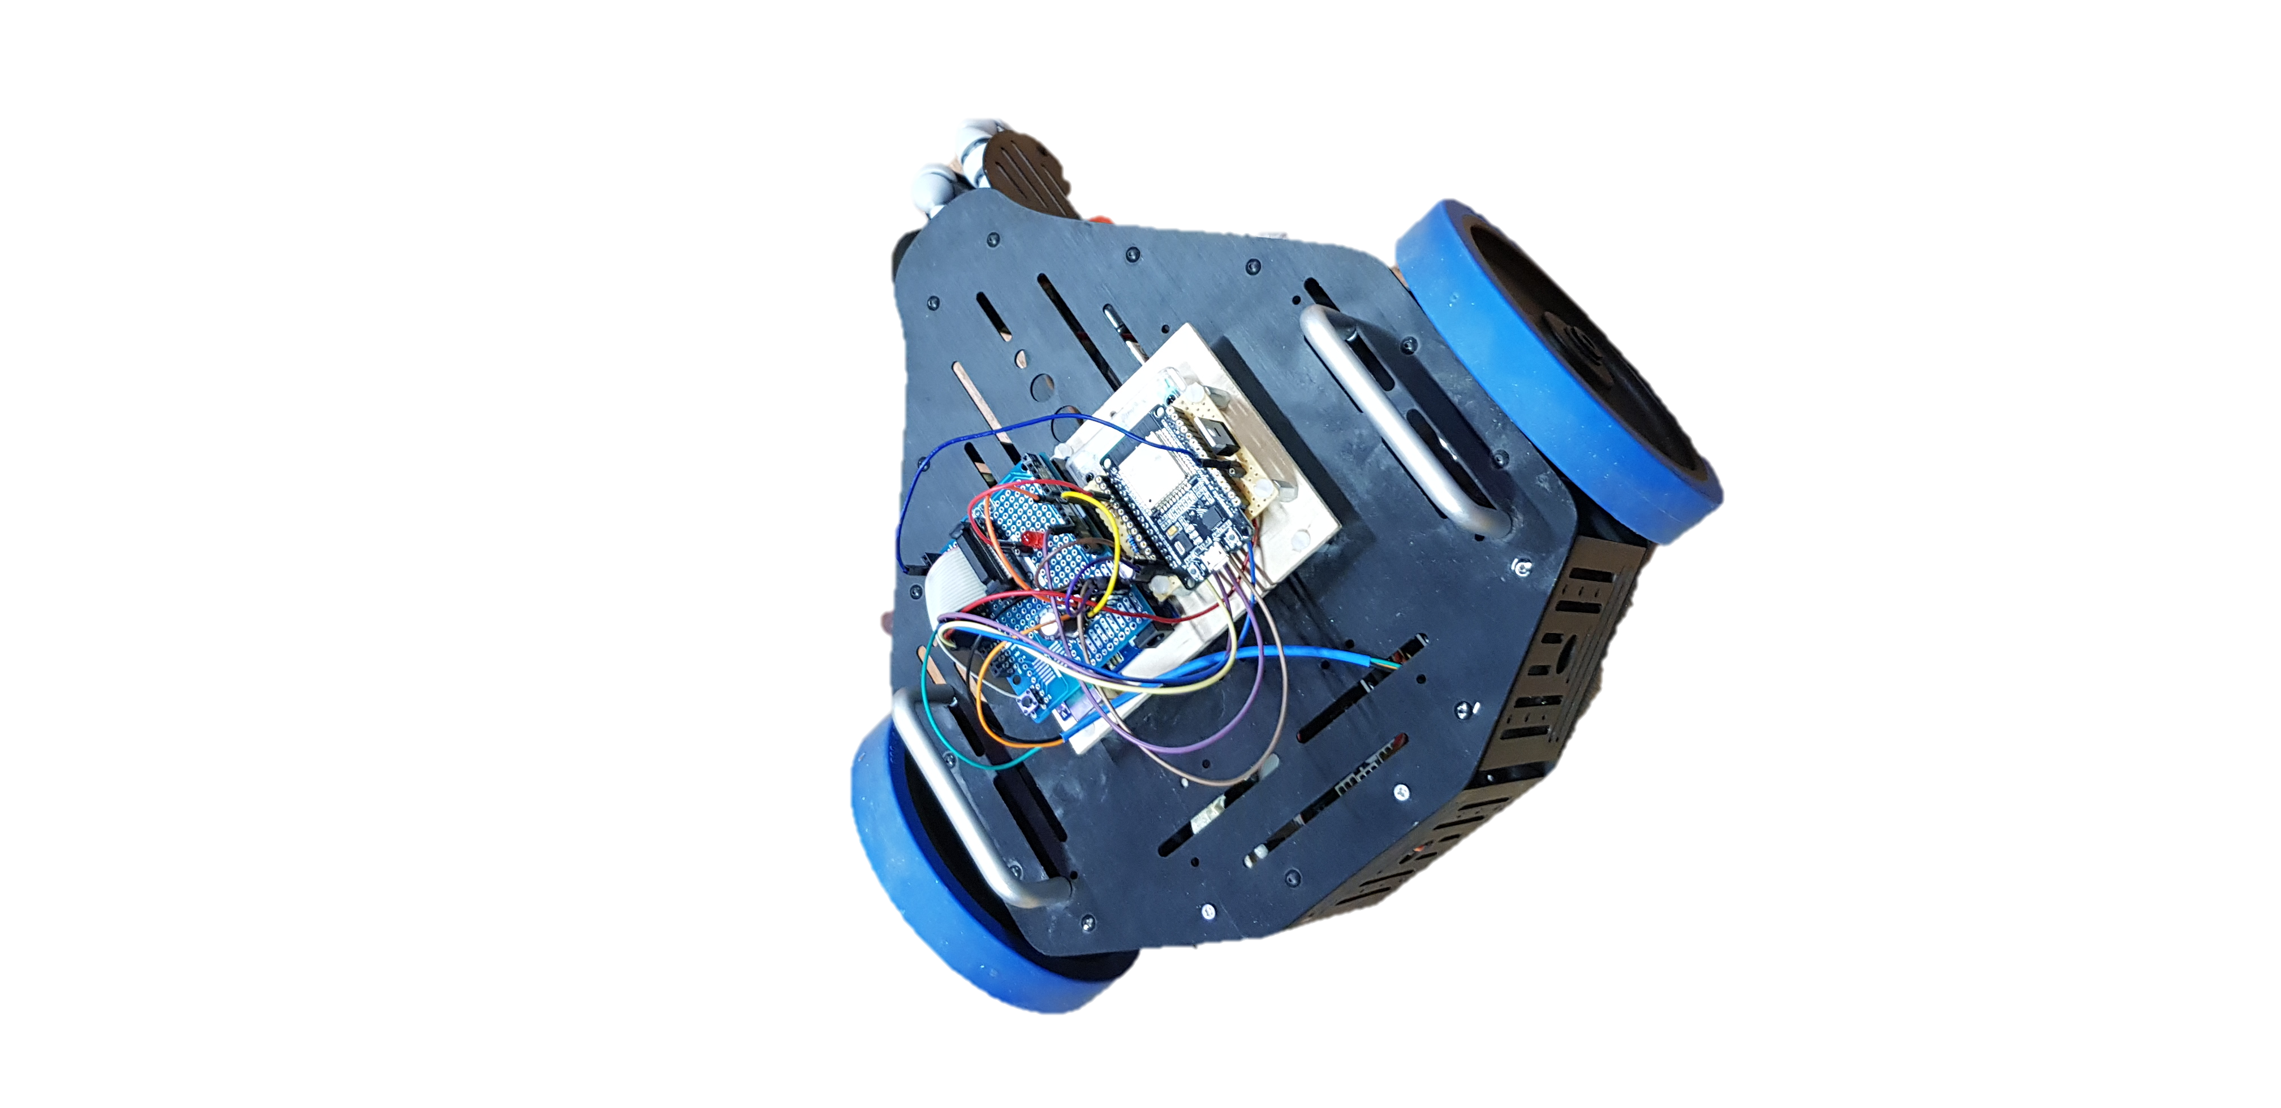
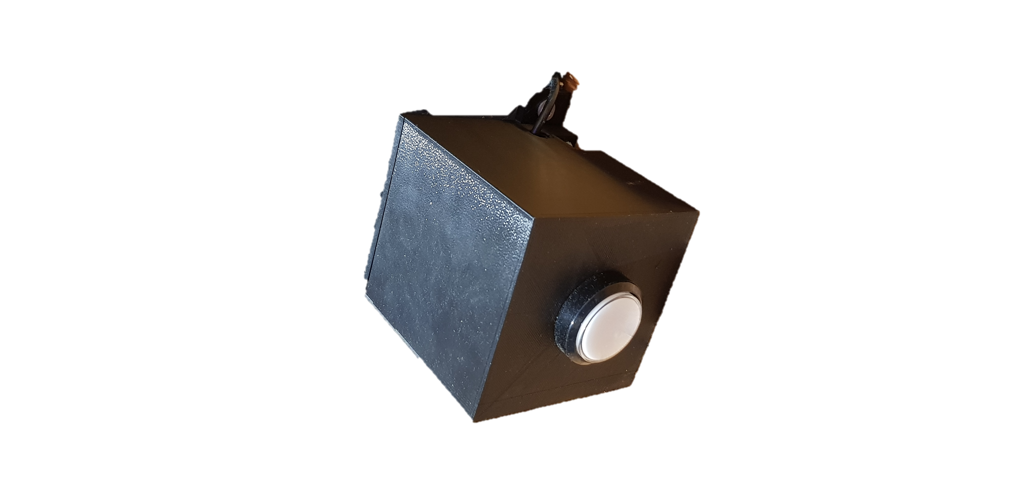
Second Door Puzzles Johannes Aslan, Maximilian Kellner, Thomas Kötzner
laser
1mW Laserpointer
pulsed at 50 Hz
Photodiode with integrated comparator used for detection of laser beam
switched on/off over MQTT and WiFi
laser is controllable with button
3D printed custom case
LED strip indicates state of laser
fusebox
designed custom PCB including 4 puzzles, power management and breakout
ESP32 to control different ICs via SPI & I2C
led matrix, 4 digit 7 segment and led ring as user interface indicating progress
using FreeRTOS as operating system & MQTT and WiFi for communication
4 different puzzles: rewiring0, rewiring1, laserDetection and potentiometer, can be solved in parallel
robot
controlled via PS2 controller
Arduino Uno reads out commands due to highly sensitive receiver
controls indicator LEDs and motors
ESP32 communicates via MQTT
switches on/off the robot
monitors the battery voltage
ESP32 inside button case sends out command to open the door in case it gets pressed

